Slide 1
Sprint 3 -Team 4 Text Mining DB Implementation & Initial text analysis
Ahmed Ashraf Sadek, Amanda Long, Zawaad Shah

Slide 2
Sprint Epics & Stories
Database Design and Implementation Epic
Implement Database on SQL Server
Data Governance Data Dictionary
Model Verification
Text Analysis Epic
SQL Alchemy with MSSQL
SpaCy Components for Text Analysis
Initial Text Analysis

Slide 3
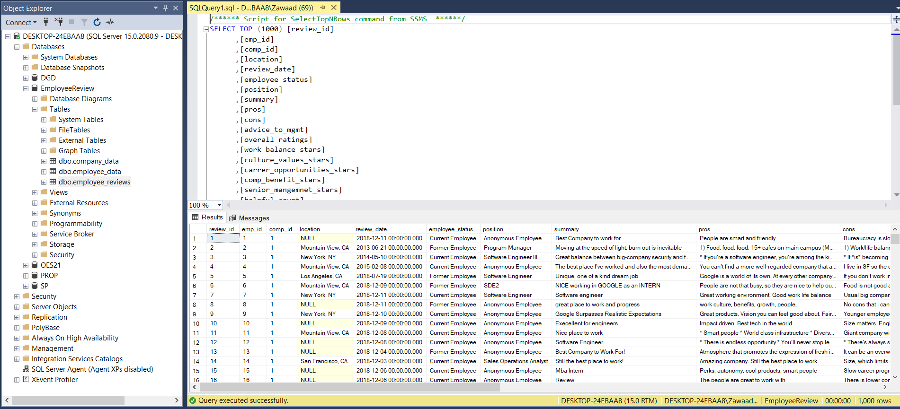
Completed database in sql server

Slide 4
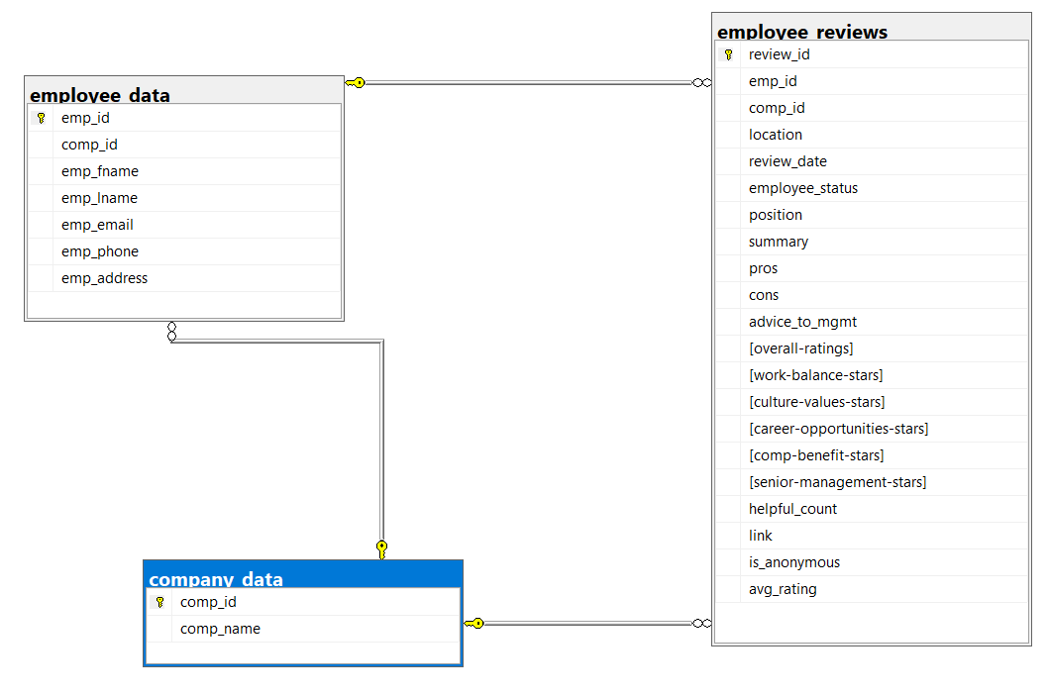

Slide 5
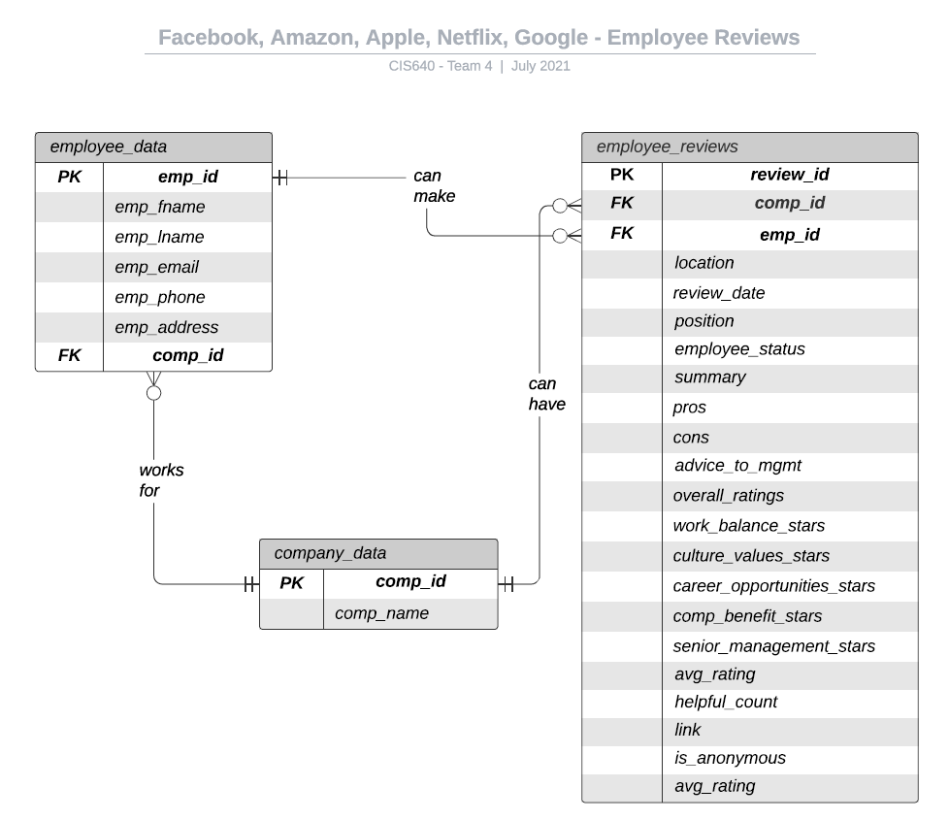
Updated entity relationship diagram

Slide 6
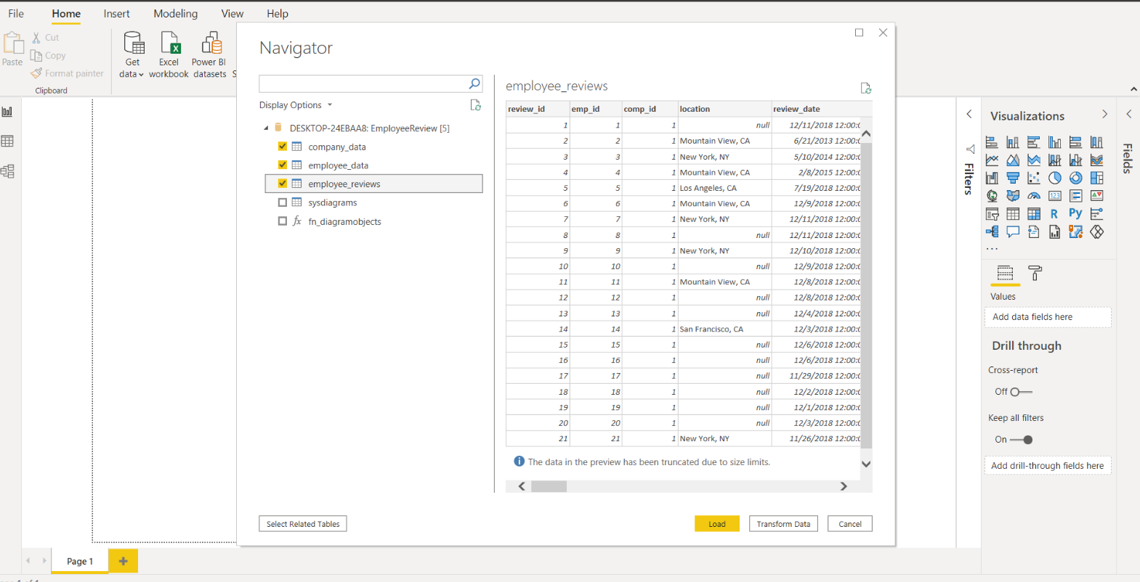
Power BI connection

Slide 7
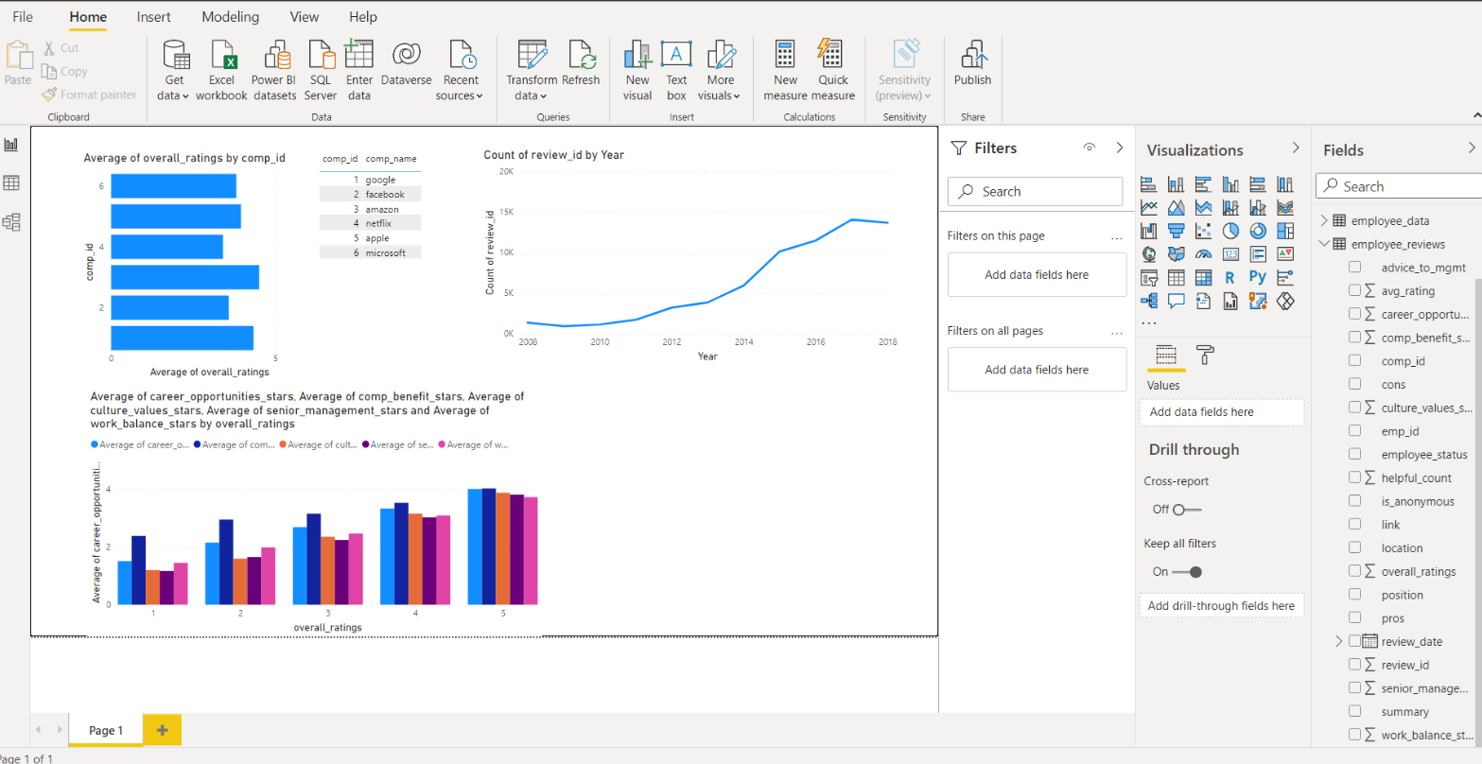

Slide 8
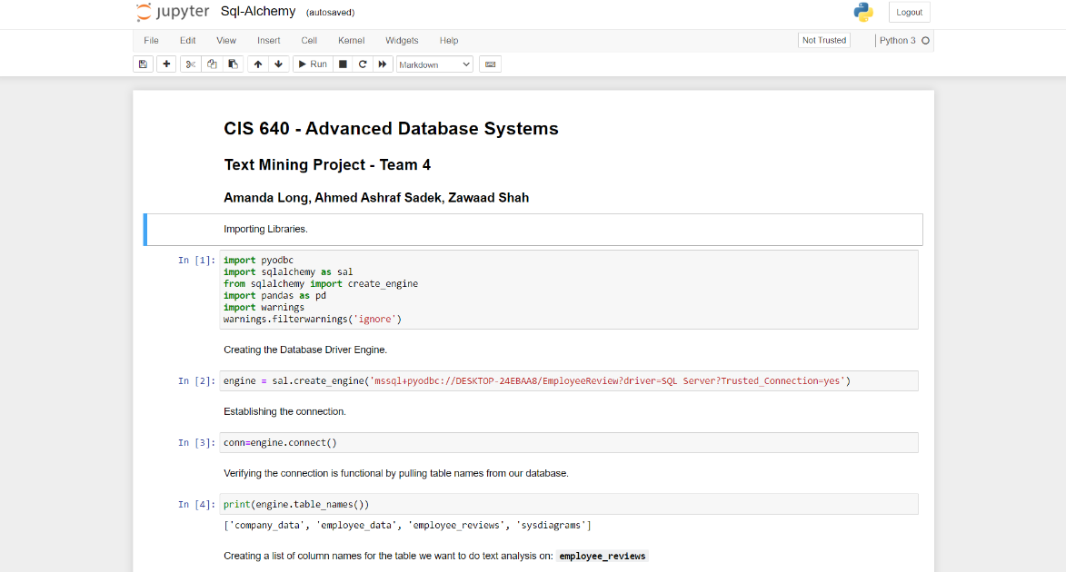
SQL Alchemy with MSSQL

Slide 9
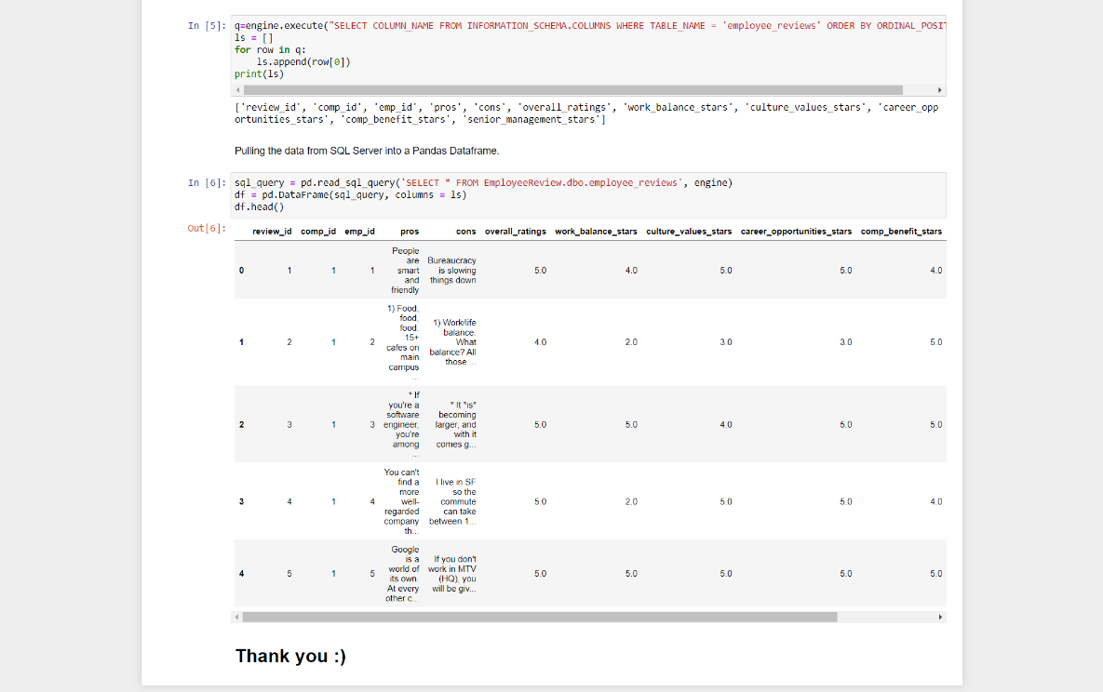

Slide 10
Data Governance & Model Verification
Added new tables to the Data Governance Data Dictionary
Met the needed Data Governance requirements
Developed scripts for adding data and updating the DG DB
Verified our database model matches the DG DB
Schema id-5
3 tables to be added- DGT000121- DGT000125
Column ids- DGT_Column_ID_761- DGT_Column_ID_800

Slide 11
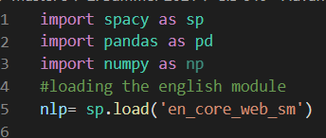
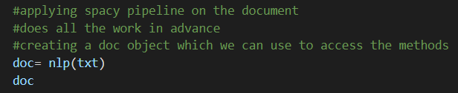
Spacy Components for Text Analysis

Slide 12
Spacy Usage – Initial text analysis
SpaCy provides a one-stop-shop for tasks commonly used in any NLP project including:
Tokenisation
Lemmatisation
Part-of-speech tagging
Entity recognition
Dependency parsing
Word-to-vector transformations

Slide 13
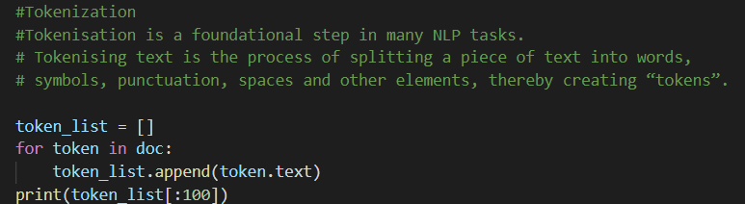
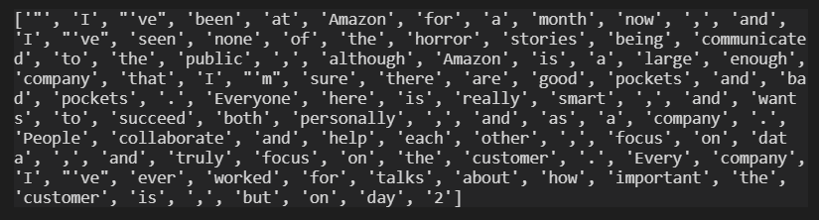
Tokenization

Slide 14
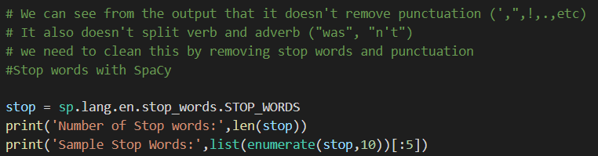
Stop Words

Slide 15
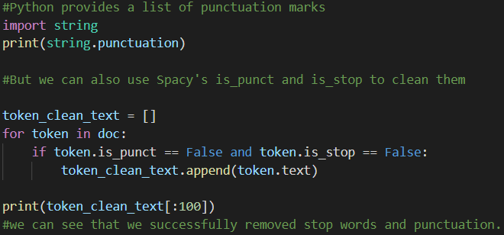
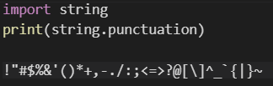
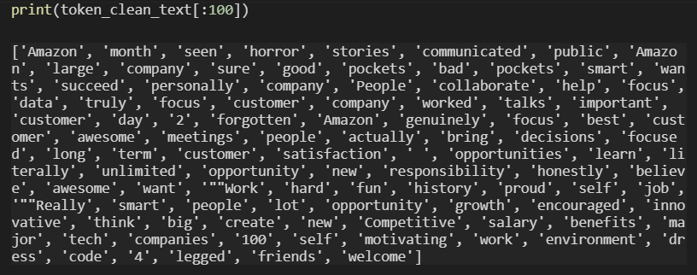
Cleaning Text Data

Slide 16
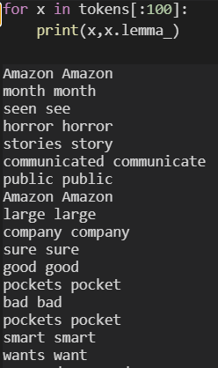
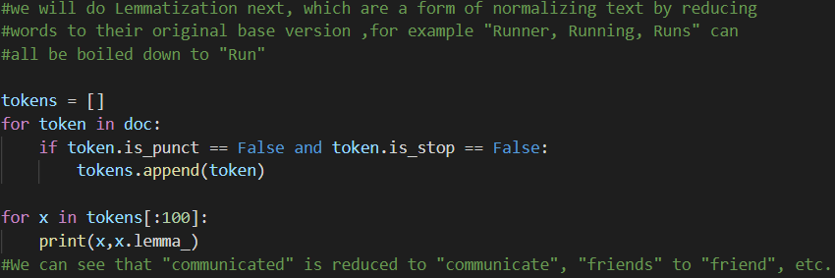
Lemmatization

Slide 17
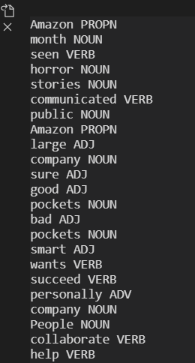
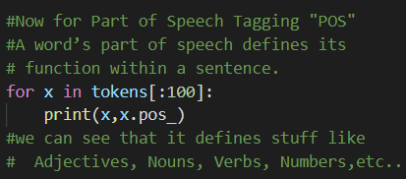
Part of speech tagging (POS)

Slide 18
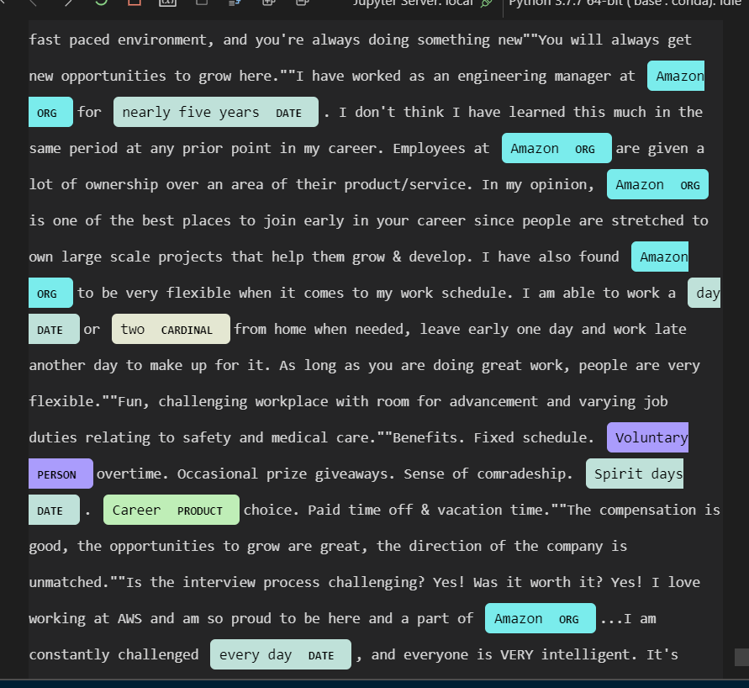
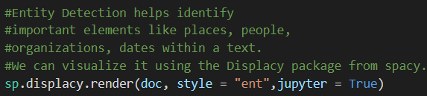
Entity detection

Slide 19
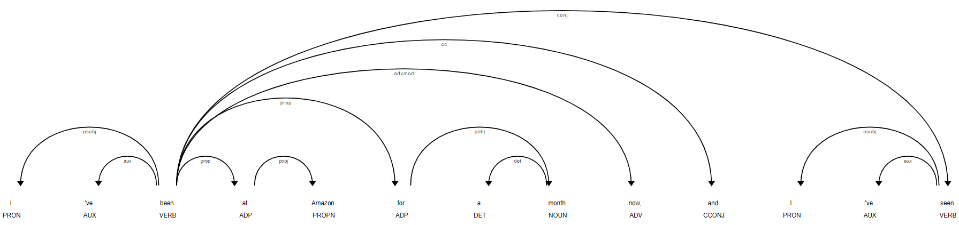
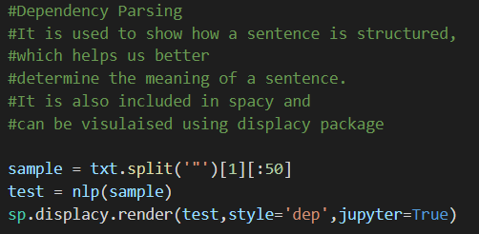
Dependency parsing

Slide 20
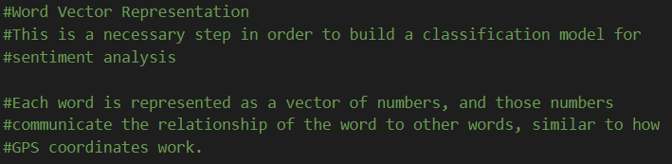
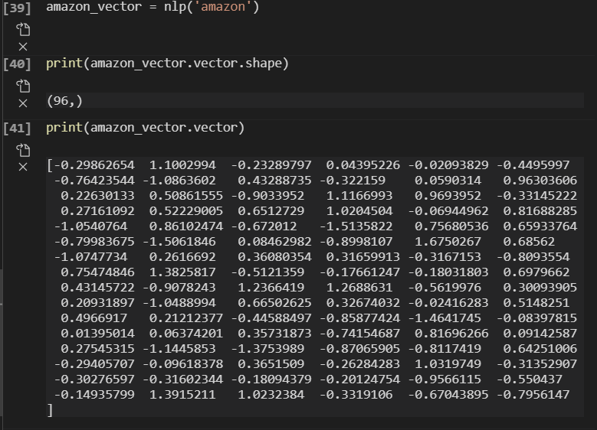
Word vector representation

Slide 21
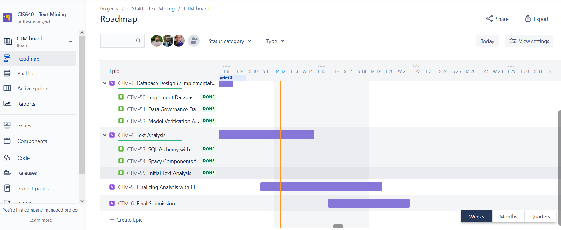
Sprint 3 – Done

Slide 22
Lessons learned
How to use SpaCy
Connecting SQL Server with python
Understanding importance of Data Governance Requirments

Slide 23
Next Sprint – Proposed Tasks
Analyze text mining results to determine potential trends within the data
Create data visulizations using Pandas (Python) and Power BI.
Create a Text Classification Model using SciKit-Learn with SpaCy outputs.
Generate Key insights regarding our dataset (Answer Business Questions).

Slide 24
Thank you ☺

